Slide 1

Autobraking System
Team 50
Taiqing Ling, Gary Gong, Weichen Qi

Slide 2
What is Autobraking System?
Autobraking System is a system that we will install on the bicycle to automatically detect stop sign and help rider to apply braking mechanism.
Basic components:
Camera (Capture STOP signs)
Raspberry pi (Template matching code)
Helmet Buzzer (Alerting)
Circuit Microcontroller
Electromagnet (Braking Mechanism)
Hall Effect Sensor (Measuring speed)

Slide 3

What problem does it solve?
Problems:
No clear bicycle traffic law enforcement
Bicycle riders sometimes do not obey the traffic law
In case the rider did not see the STOP sign at all

Slide 4
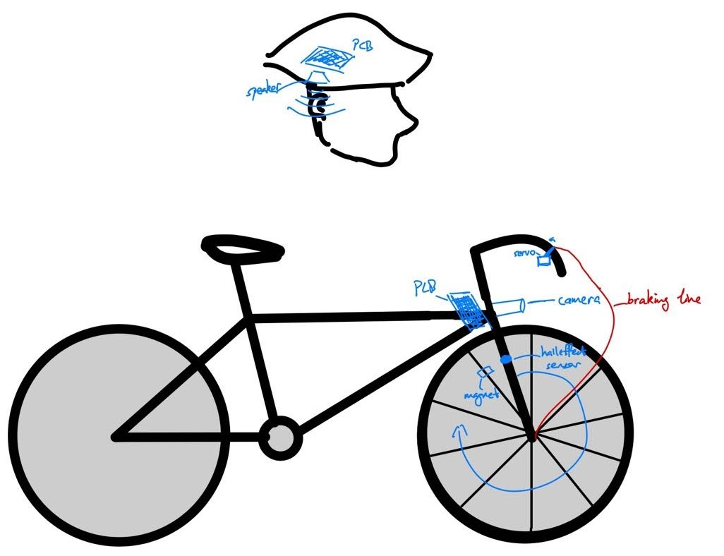
Visual Aid
E-magnet

Slide 5
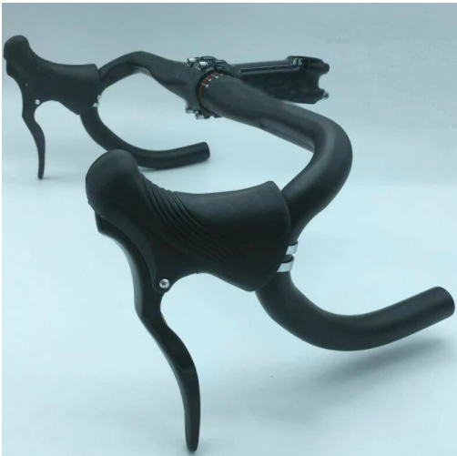
Visual Aid: brake
E-magnet
Iron panel

Slide 6
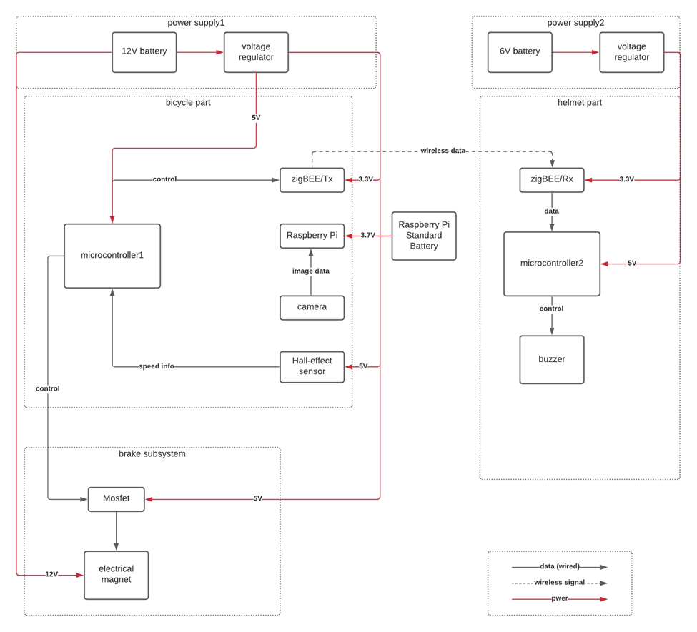
BLOCK DIAGRAM:
Modules:
Voltage Regulator (5V, 3.3V)
Microcontroller
XBEE (Wireless Connection)
Button (False Alarm)
Hall Effect Sensor
Electromagnet
Raspberry Pi

Slide 7
Schematics: Voltage Regulator

Slide 8
Schematics: Microcontroller

Slide 9
Schematics: USB Module

Slide 10
Schematics: Button, Mosfet, Electromagnet, and Hall Effect Sensor

Slide 11
Schematics: XBEE

Slide 12
Schematics: Buzzer

Slide 13
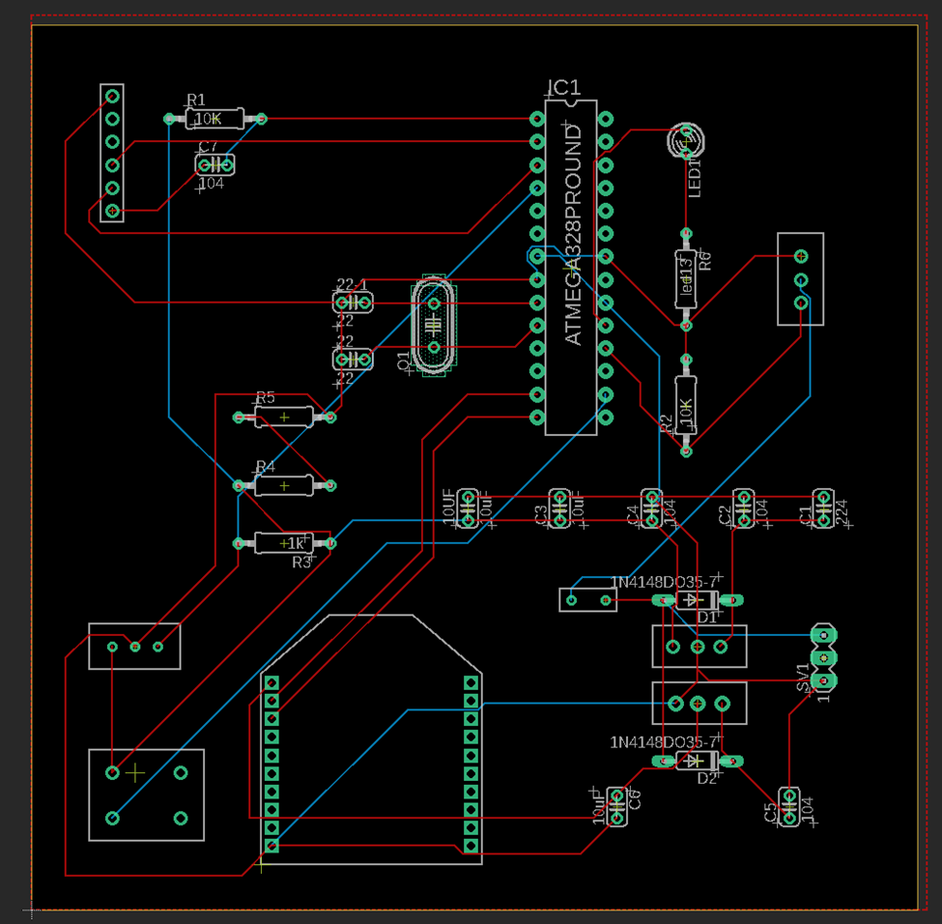
PCB Layout1:
Microcontroller PCB

Slide 14
PCB Layout2:
Helmet

Slide 15
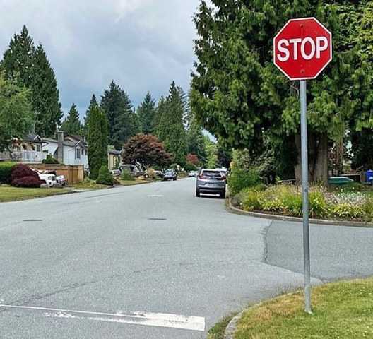

Template Match
* Determine if there is a region in the image that looks like the template.

Slide 16
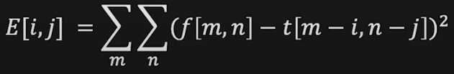
Template Match by correlation
Minimize the difference between raw image and template
= Maximize the correlation
Correlation coefficient: a measurement of relationship between 2 variables

Slide 17
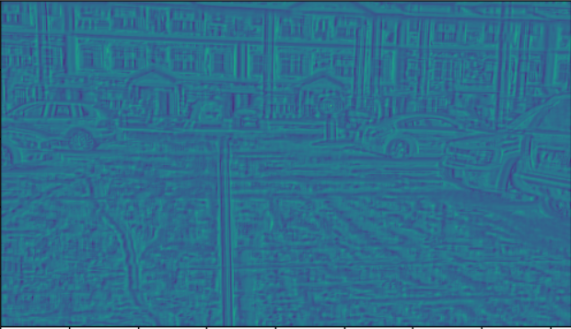
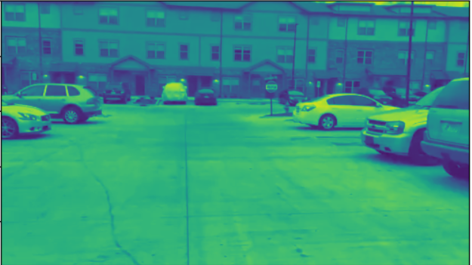
Correlation outputs
Scale the correlation matrix to 0~255
Match result

Slide 18
Why gray scaled?
Triple speed
RGB (dim=3) → Illuminance(dim=1)

Slide 19
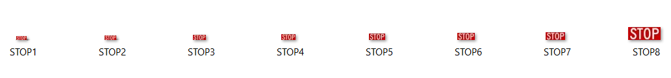
Code logic
Main Thread:
* Store all templates in a list, convert them to gray scales
* Fetch the latest frame
* Loop over all templates to see if there is a match of any of them
* Send signal through USB port to the microcontroller
* Go to step2
Camera Thread:
* Fetch the latest frame and store into a shared variable

Slide 20
Performance
* threshold correlation = 0.58
* running time on computer: 0.03~0.24s (480p)
* running time on Raspberry Pi (2GB): 0.3s (150x200)
* false positive: 0%
* maximum detection distance: 17m

Slide 21
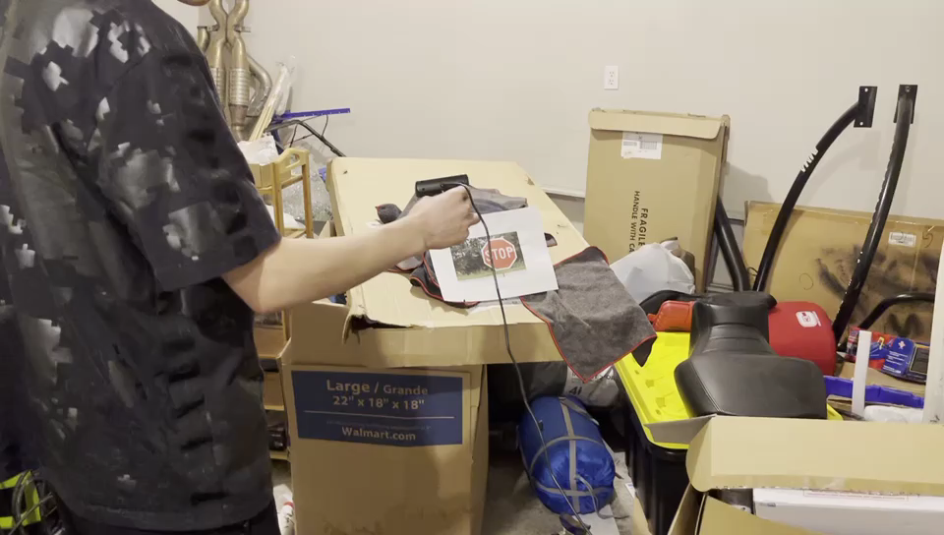
Project Demo

Slide 22
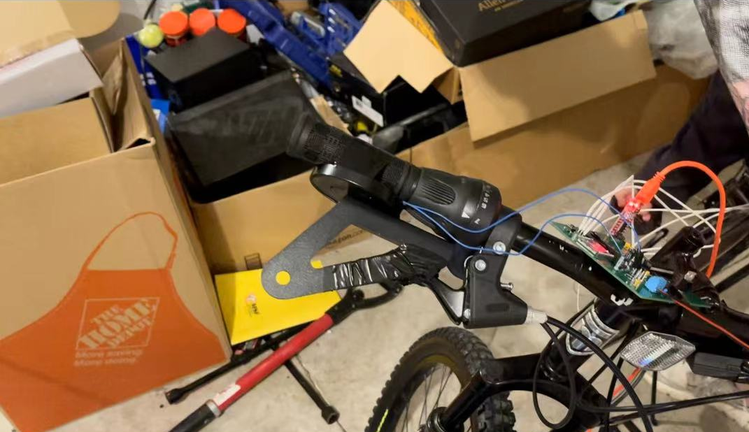
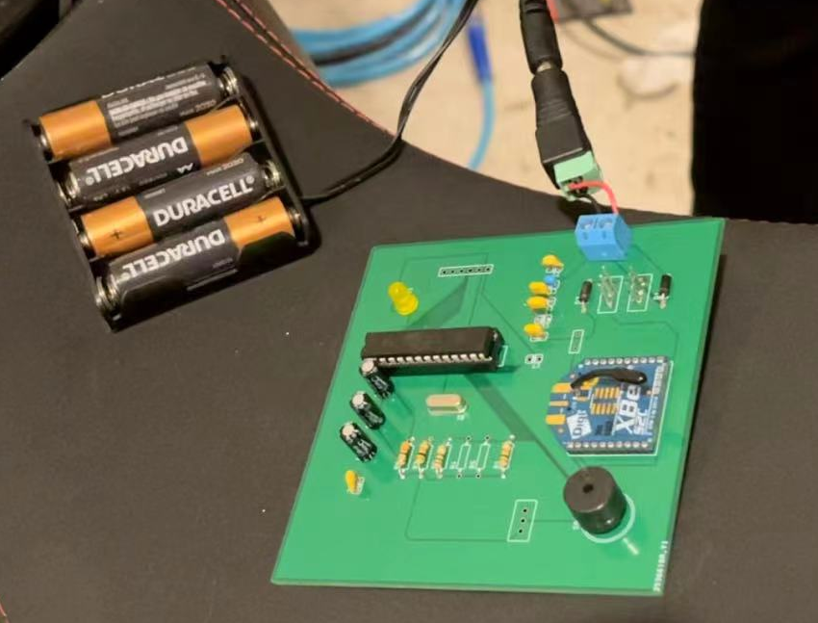
Main Project Components:
Electromagnet Braking Mechanism & Microcontroller
Helmet PCB (Alerting Buzzer)

Slide 23
What can we improve? (Conclusion)
Cameras:
Need a camera with less exposure
Braking Mechanism:
Change the electromagnet with larger magnetic field
Use Servo motor instead
Template Matching Algorithm:
Make more template to detect tilted STOP sign

Slide 24

Thank you!

